Slide 1
502045
Software Engineering
Chapter 07
Lesson 10: Version Control

Slide 2
Contents
What is version control
History and evolution of version control
Approaches
Domain vocabulary

Slide 3
What is version control
Place to store your source code
Historical record of what you have done over time

Slide 4
VCS Classification (by repository model)
Centralized (client-server model)
Subversion
CVS
VSS, TFS, Vault
ClearCase
AccuRev
Distributed
Git
Mercurial
Bazzar
Perforce
BitKeeper

Slide 5
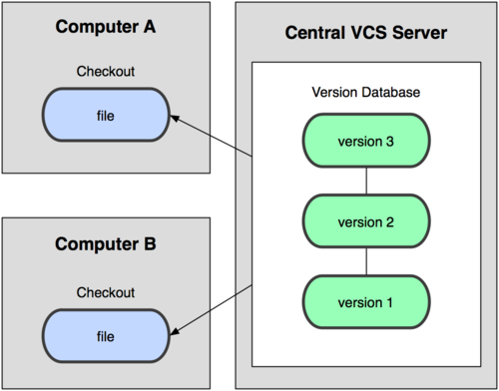
Centralized model

Slide 6
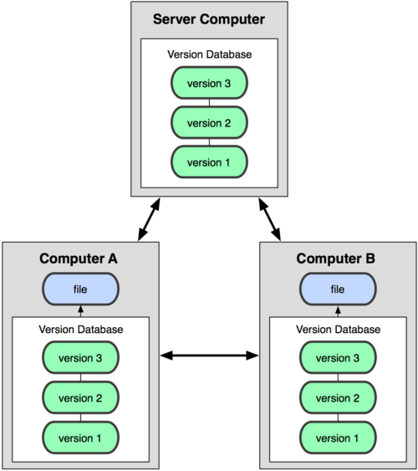
Distributed model

Slide 7
Distributed vs centralized. Differences
Centralized
Distributed
Single repository
Commit requires connection
Impossible to commit changes to another user
All history in one place
Easy access management
Chosen for enterprise development
Multiple repositories
Commit does not require connection
Possible to commit changes to another user
Impossible to get all history
Chosen for open source development
Notes:
Как вывод – центр. – для enterprise разработки, дистр. – для open source

Slide 8
Environment
Repository
Where files’ current and historical data are stored.
Server
A machine serving the repository.
Client
The client machine connecting to the server.
Working copy
Local copy where the developer changes the code.

Slide 9


Environment
Client
Server
Working copy
Repository

Slide 10
Basic operations
Add
Mark a file or folder to be versioned
Change
Create any changes in the local copy
Commit
Send changes to the repository
Revert
Discard local changes and go back to the same last known revision from the repository
Update
Synchronize changes from the repository to the local copy

Slide 11


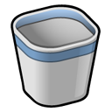



Basic operations
Revert
Add
Foobar.txt
Foobar.txt
Commit
Commit
Change
Delete
Commit
Revert
Foobar.txt
Foobar.txt

Slide 12
Basic operations
Jerry
1219
1220
1221
1222
Commit
Server
1222
1219
1220
1221
Update
Tom
1219
1220
1221
1222

Slide 13


Domain vocabulary. CVCS workflow example
WC (working copy)
Repository
svn add
svn commit
svn update

Slide 14
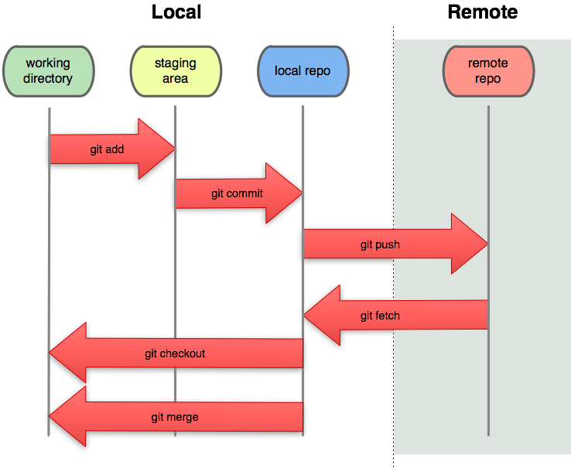
Domain vocabulary. DVCS workflow example

Slide 15
Basic artifacts
Revision
Set of changes, state of the code in a point of time
Changelog
Sequential view of the changes done to the code, stored in the repository

Slide 16
Revision
Last revision (head)
harry
1222
file1.txt
file2.txt
file4.txt
Refactoring of module C.
Changelog
dick
1221
file2.txt
file4.txt
Including BUG B.
tom
1220
file1.txt
file3.txt
Including feature A.
Revision number
fulano
1219
file1.txt
file2.txt
file3.txt
file4.txt
Revision author
First inclusion
Description message
Timeline
Changed files
Revision

Slide 17

Domain vocabulary. Repository layout
Repository
/
/trunk
/branches
/tags
Mainline
Branches directory
Tags directory

Slide 18
Labels
Tags
Comprehensive alias for existing revisions, marking an important snapshot in time

Slide 19
Labels
1.0.2
Tags
harry
1222
1222
file1.txt
file2.txt
file4.txt
Refactoring of module C.
1221
tom
1221
file2.txt
file4.txt
Including BUG B.
1220
dick
1220
file1.txt
file3.txt
Including feature A.
1.0.1
tom
1219
1219
file1.txt
file2.txt
file3.txt
file4.txt
First inclusion.

Slide 20
Changes
Diffs and Patches
The comparison between two text files is done by an application diff-like that feeds an application patch-like capable of redo the changes from the originating state to the destination state.
This operation of computing the differences is normally referred as diff, while the “file containing the differences”, that could be exchanged in e-mails and other eletronic media, is denominated patch.

Slide 21
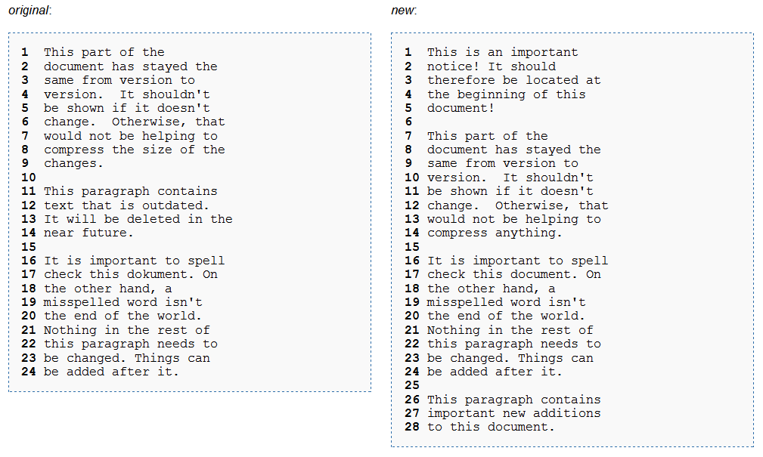
Changes – Example

Slide 22
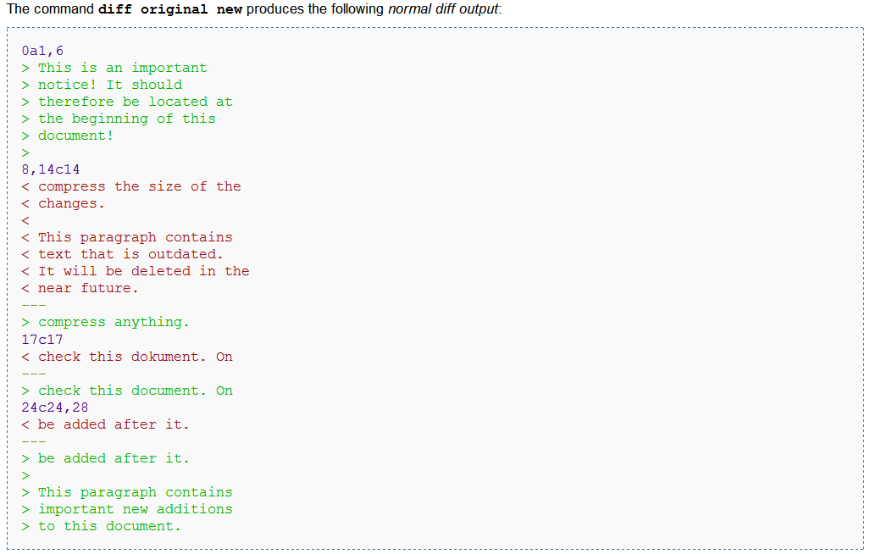
Diff file or patch

Slide 23
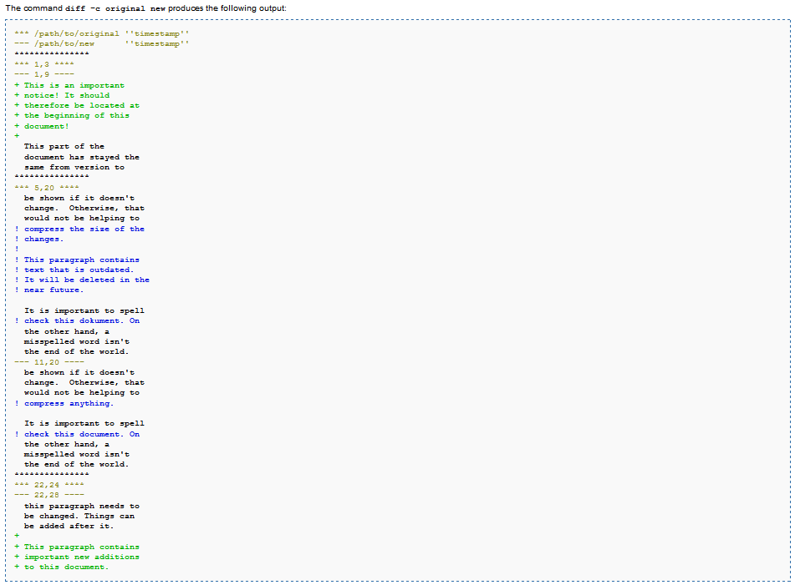
Diff file or patch

Slide 24
Changes
diff 1
diff 2
diff 3
diff 4
1218
1219
1220
1221
1222

Slide 25
Branches
Z
Create branch
X
Create branch
Y
Create branch
W

Slide 26
Merge
In some point of the development, the code must be merged.

Slide 27
Merge
X
Merge
Y

Slide 28
Conflicts
When the changes are done in the same source file lines, you can have conflicts.

Slide 29
How to solve conflicts?
Question:
Is it possible to solve these conflicts automatically?

Slide 30
How to solve conflicts?
Answer: No!!!
Even when don’t have changes in the same source line, you can still have semantic problems in the code. So, always double check before to commit.

Slide 31
How to solve conflicts?
A note before continuing:
It is always better to avoid unnecessary conflicts.
Communicate your development, always include a description in your committed revisions, ask for help if you don’t understand anything, etc.

Slide 32
How to solve conflicts?
Two way merge
A
A
working base
B
working copy
C = A + B
output
B
C

Slide 33
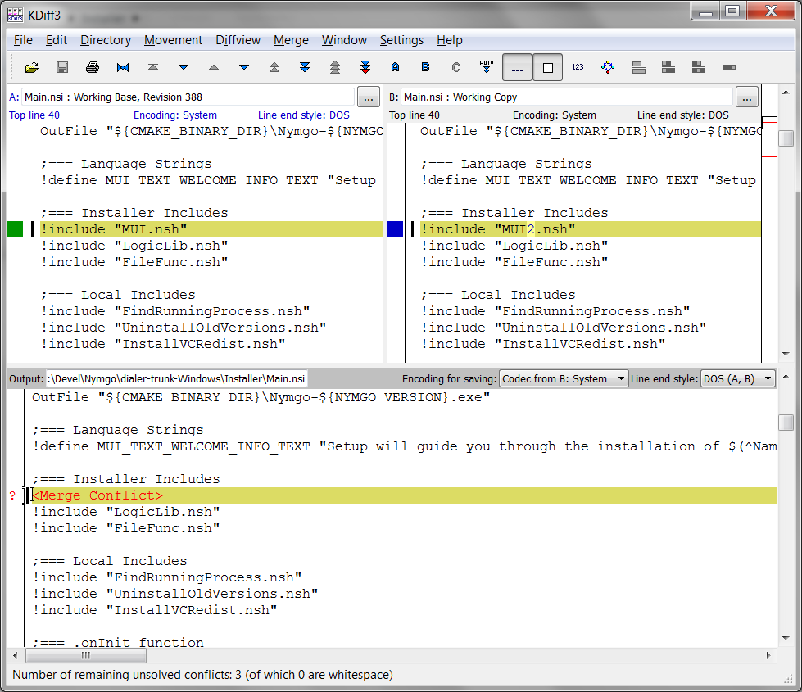
Tools: KDiff3

Slide 34
How to solve conflicts?
Three way merge
B
A
origin
B
branch #1
C
branch #2
Merge
D = A + B + C
Create branch
A
C
D

Slide 35
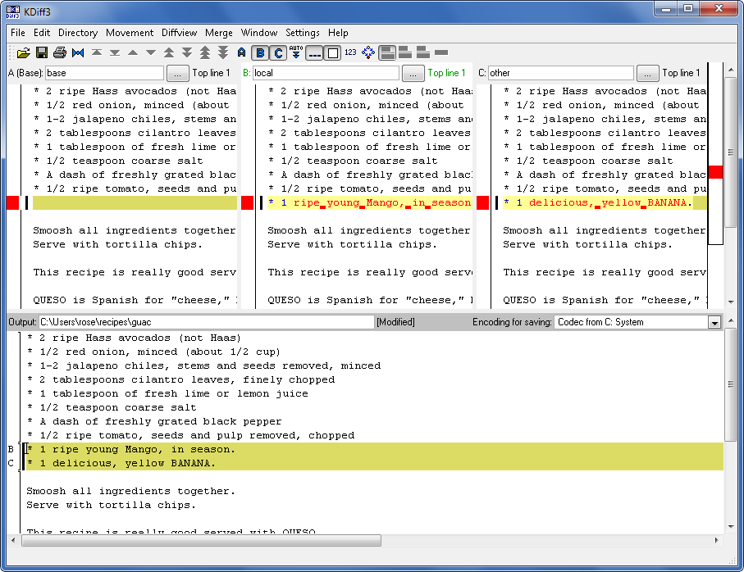
Tools: KDiff3

Slide 36
Branching Patterns
How to manage the branches during the software lifecycle

Slide 37
Mainline
1.0
1.0.1
branch
merge
1.1
1.1.1
1.1.2
branch
merge
1.2
1.2.1
1.2.2
branch
merge
merge
2.0
2.0.1

Slide 38
Mainline
Bring a fix from branch n to branch m require m-n merges (linear complexity with the number of branches).

Slide 39
Mainline
Learned lesson:
Perform merges the early and frequently as possible.

Slide 40
Mainline / Variant
2.0
2.0.1
branch
1.2
1.2.1
1.2.2
merge
branch
merge
merge
mainline
branch
branch
merge
merge
1.1
3.0
1.1.1

Slide 41
Scenario:
You just developed a stable version of the software and you need to create a new version with new features and still provide small fixes for the last stable version.

Slide 42
Parallel Maintenance / Development Lines
Most used option
1.1
1.1.1
1.1.2
merge
merge
devel
1.0.0
branch
2.0.1

Slide 43
Parallel Maintenance / Development Lines
Note the internal branch
2.0
2.0.1
2.0.2
merge
merge
devel
1.0.0
branch
branch
merge
merge
1.1
1.1.1

Slide 44
Scenario:
You need to develop two different features in a short period of time.
(laughts)

Slide 45
Overlapping Release Lines
mainline
branch
func_1
merge
branch
merge
merge
func_2

Slide 46
Scenario:
You allocated a new developer to work in a too risky code base and you want to moderate his/her changes for a while.

Slide 47

Docking Line
devel
merge
merge
merge
moderador
sync
sync
sync
docking
line
change,
stabilize
change,
stabilize
change,
stabilize
desenvolvedor

Slide 48
Scenario:
Your development tasks need to progress in discrete levels of maturity: (1) change proposals, (2) analysis, (3) review, (4) unit tests, (5) integration tests, (6) system tests, etc.

Slide 49

Staged Integration Lines
devel
propostas
(1)
revisão
(2)
testes
(3)

Slide 50
When to create a branch?
Some most common patterns.

Slide 51
Branch per Delivery
1.0
1.1
1.2
1.3
Release 1
Create branch
Merge
Release 2
2.0
2.1
2.2
2.3

Slide 52
Branch per Task
Task 1
1.0
1.1
1.2
Devel
Task 2

Slide 53
Branch per Component
Component A
1.0
1.1
1.2
Devel
Components A + B
Component B

Slide 54
Branch per Technology
1.1
Android
1.1
1.2
Common
1.1
1.2
iOS

Slide 55
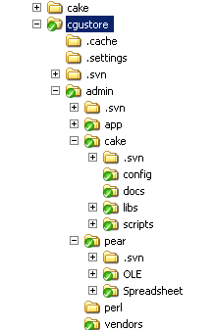
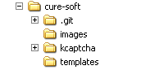
Domain vocabulary - Metainfo
working copy
under subversion
working copy under git
metainfo
WC under subversion has .svn folder in each directory
It allows tracking files status easily
But has disadvantages
It takes too long to delete WC from FS
FTP upload is a headache
Web-application deployed together with .svn folders is a security threat
It is easy to delete standalone .svn folder and have some problems

Slide 56



Working copy file status
working revision
.svn
timestamp (last updated)
Unchanged, and current
Unchanged, and out of date
14
18
=
14
~
Locally changed, and current
Locally changed, and out of date

